Slide 1
NAAN MUDHALVAN
AHAMED SHAFHAN

Slide 2


Introduction to Keyloggers
In the digital age, keyloggers - stealthy software tools - pose a grave threat. These malicious programs secretly monitor and record user keystrokes, enabling capture of sensitive information that can lead to identity theft, financial fraud, and privacy breaches.
Notes:
<number>

Slide 3

What are Keyloggers?
Keyloggers are surreptitious programs that silently track every keystroke made on a computer. They covertly gather data such as login credentials, credit card numbers, and personal messages - information that can be exploited by cybercriminals for malicious purposes.
Notes:
<number>

Slide 4




How Keyloggers Work
Installation
Monitoring
Data Exfiltration
Keyloggers can be secretly installed on a target system through various means, such as malware, phishing attacks, or physical access to the device.
Once installed, the keylogger silently records every keystroke made on the computer, including passwords, credit card numbers, and other sensitive data.
The captured information is then transmitted to the attacker, often through the internet, enabling remote access to the victim's accounts and personal details.
Notes:
<number>

Slide 5
Keyloggers and Identity Theft
Credential Theft
Financial Damage
Privacy Violations
Keyloggers can capture login credentials, providing cybercriminals with the means to access a victim's online accounts and steal their identity.
With access to a victim's personal and financial information, identity thieves can open new credit accounts, make fraudulent purchases, and wreak havoc on the victim's credit history.
Keyloggers can expose sensitive personal communications, medical records, and other confidential information, leading to significant privacy breaches and emotional distress for the victim.
Notes:
<number>

Slide 6

Keyloggers and Financial Fraud
1
Credit Card Theft
2
Online Banking Compromise
Keyloggers can capture credit card numbers, expiration dates, and CVV codes, enabling cybercriminals to make fraudulent purchases and drain victims' financial accounts.
By obtaining login credentials, keyloggers allow attackers to access victims' online banking portals, transferring funds and making unauthorized transactions.
3
Investment Account Tampering
Keyloggers can also compromise investment accounts, allowing criminals to manipulate portfolios, make unauthorized trades, and steal valuable assets.
Notes:
<number>

Slide 7




Protecting Against Keyloggers
Strong Passwords
Anti-Malware Protection
Vigilant Monitoring
Biometric Authentication
Use complex, unique passwords for all accounts to minimize the risk of credential theft.
Install robust antivirus and anti-malware software to detect and remove keyloggers and other malicious programs.
Regularly check for any unusual computer activity or unexplained changes to regularly used applications.
Utilize biometric security features, such as fingerprint or facial recognition, to supplement traditional password-based authentication.
Notes:
<number>

Slide 8
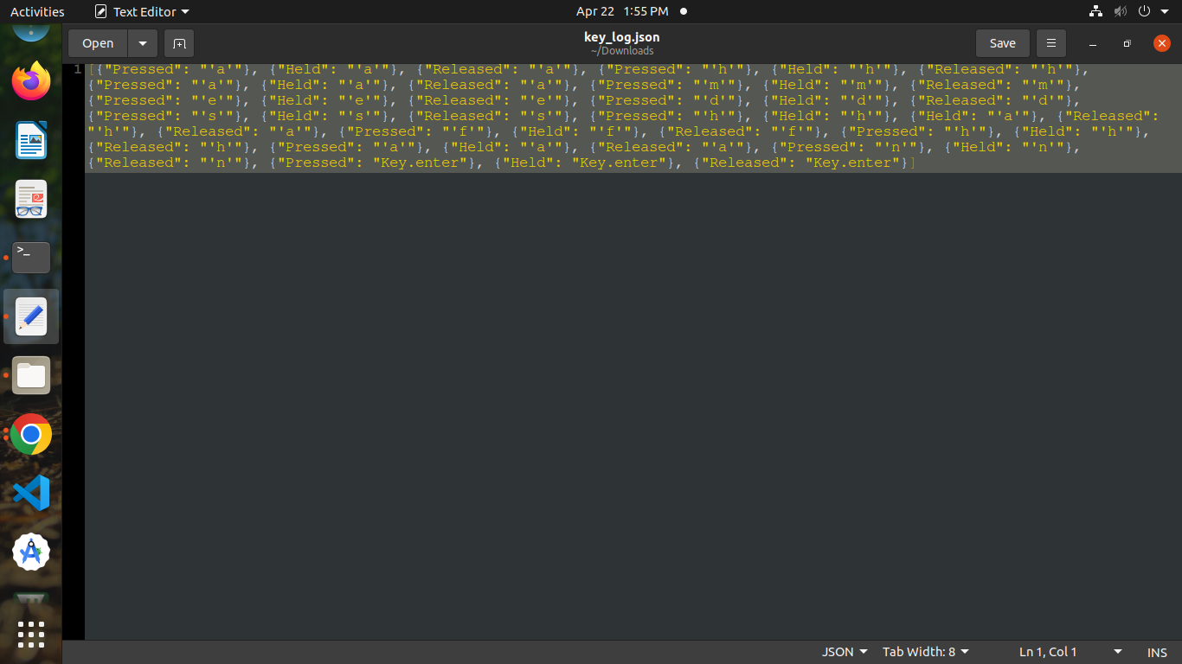
RESULT:

Slide 9

Conclusion and Recommendations
Stay Vigilant
Prioritize Cybersecurity
Remain alert to the threat of keyloggers and regularly monitor your devices and online accounts for any suspicious activity.
Invest in robust cybersecurity measures, such as antivirus software, firewalls, and secure internet browsing practices, to protect against keyloggers and other cyber threats.
Educate Yourself
Continuously educate yourself and your loved ones on the latest keylogger threats and best practices for safeguarding your digital identity and financial well-being.
Notes:
<number>

Slide 10
Future Scope
AI-Powered Keyloggers
1
Advancements in artificial intelligence may lead to more sophisticated keyloggers capable of bypassing traditional security measures and evading detection.
2
Biometric Keyloggers
Emerging technologies could enable keyloggers to target biometric authentication systems, such as fingerprint and facial recognition, compromising the security of these advanced authentication methods.
Quantum Computing Threats
3
The advent of quantum computing could potentially break current encryption standards, making it easier for keyloggers to intercept and decrypt sensitive data in real-time.
Notes:
<number>

Slide 11
THANK YOU

